Slide 1
WELCOME

Slide 2
A Project on
“Automatic Multipurpose Agri Robot”.
Guide By:- Prof.K.K.Pandyaji .
Presented By :-
1.Miss.Dhulubulu Sneha M.
2.Miss. Pise Geetanjali D.
3.Mr. Shinde Rahul B.

Slide 3
Introduction:
Pollution is a major issue for whole world. Pollution is manmade and can be seen everywhere. The appliances used in agriculture is mainly depends on a gas kit, various fuels, kerosene. Those are provide large pollution, it affects the human life and also the environment. In case Gas powered grass cutter due to the emission of gases it is responsible for pollution. Also the cost of fuel is increasing hence it is not efficient. There are various methods which are used for grass cutting but they works on either manpower or electrical power supply which increases cost. But there is tremendous amount of solar energy present on the earth so we can use this energy for grass cutting and water sprinkling purpose.

Slide 4
Proposed Work :-
The rays coming from sun are made to fall on the solar panel.
The conversion of sun light into electricity takes place instantly.
The solar panel is kept at an angle perpendicular to sun rays such that maximum rays are falls on the panel, energy receiving from sun used to produce electricity and stored in a battery.
Electrical energy of the battery is converted to mechanical energy through a grass cutter & also this energy is use to sprinkling purpose.

Slide 5
Block Diagram:-
Solar Panel
Battery
Arduino
Alarm
Ultrasonic Sensor
Motor Driver
Motor
Motor Driver
Cutter motor
Motor Driver
Pump Motor
Motor Software
Flood Sensor
Water Tank

Slide 6
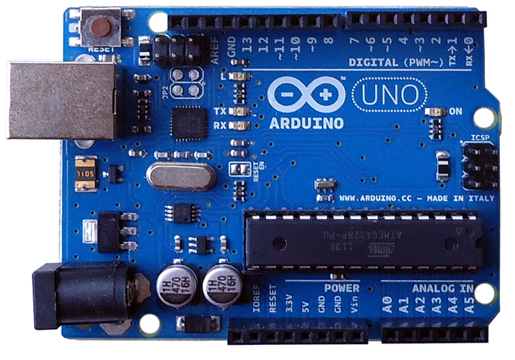
1] Arduino:-
The Arduino Uno is a microcontroller
board based on the ATmega328 (datasheet).
It has 14 digital input/output pins
(of which 6 can be used as PWM outputs),
6 analog inputs, a 16 MHz ceramic resonator,
USB connection,
power jack.,
ICSP header and
Reset button.
Fig. Arduino Uno

Slide 7
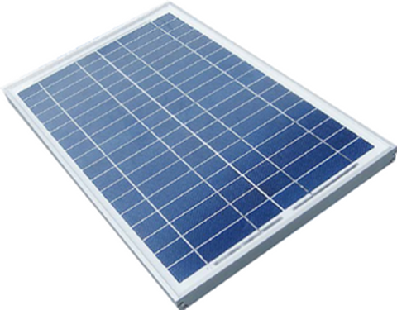
2] Solar Panel:-
Solar panel is a collection of solar cell.
Lots of small cells spread overall large area can work together to provide enough power to be useful.
This device that convert sun light into electricity.
Photovoltaic Principle.
fig. Solar Panel

Slide 8
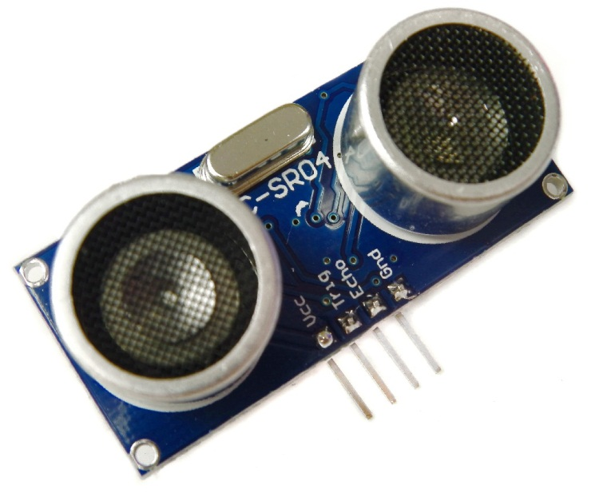
Ultrasonic sensor:-
Ultrasonic ranging module HC - SR04 provides
2cm - 400cm non-contact measurement function,
The ranging accuracy can reach to 3mm.
The modules includes ultrasonic
transmitters, receiver and control circuit.

Slide 9
The basic principle of work:
(1) Using IO trigger for at least 10us high level signal,
(2) The Module automatically sends eight 40 kHz
and detect whether there is a pulse signal back.
(3) IF the signal back, through high level , time of high output IO duration is the time from sending ultrasonic to returning.
Test distance = (high level time velocity of sound (340M/S)/2).

Slide 10
Motor driver:-
A motor driver is a little current amplifier; the function of motor drivers is to take a low-current control signal and then turn it into a higher-current signal that can drive a motor.
L293 is a typical Motor driven or Motor Driver IC.
Which allows DC Motor to drive on either direction.
L239d id a 16 pin IC which control a set of two DC motors simultaneously in any direction.
It means that you can control two Dc motor with singe L293D IC.

Slide 11
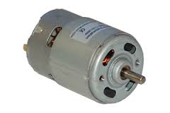
D C Motor:-
A DC motor is any of a class of electrical machines that converts direct current
electrical power into mechanical power.
The most common types rely on the forces produced by magnetic fields.

Slide 12
Nearly all types of DC motors have some internal mechanism, either electromechanical or electronic; to periodically change the direction of current flow in part of the motor.
Most types produce rotary motion; a linear motor directly produces force and motion in a straight line.

Slide 13
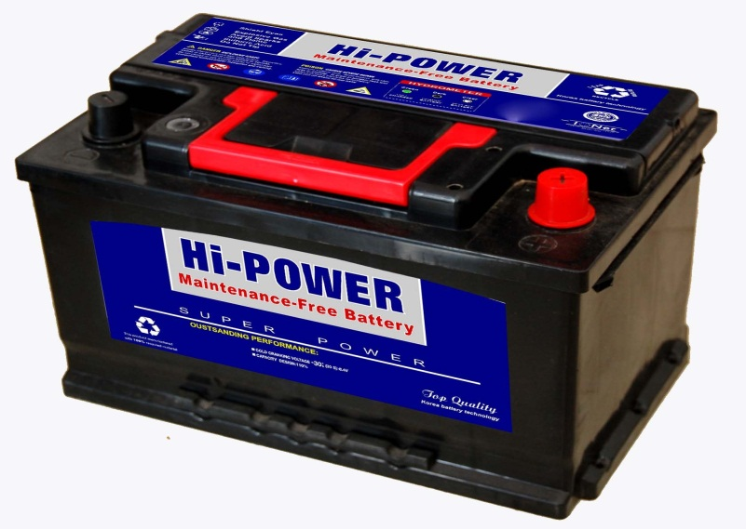
Battery:-
An electric battery is a device consisting of one or more electrochemical cells with external connections provided to power electrical devices such as flashlights, smartphones, and electric cars.
When a battery is supplying electric power, its positive terminal is the cathode and its negative terminal is the anode.

Slide 14
The terminal marked negative is the source of electrons that when connected to an external circuit will flow and deliver energy to an external device.

Slide 15
Alarm:-
An alarm system is an electronic installation that
Consists of input and output device, a control panel, and their respective wiring.
Flood sensor:-
A flood sensor is a small sensor that detects water levels in water tank.
Water tank:-
Water tank is use for water storage purpose.

Slide 16
Flow Chart:-
Flow Chart:-
start
Tank Level?
N
Robot Stop
Y
Robot forward
Sprinkler On
Cutter On
C
N
If Obstacle
B
Y
Stop Robot
Turn robot 90⁰ left
A

Slide 17
2)
Turn robot 180⁰ right
A
B
Y
If Obstacle?
Y
Robot back
If Obstacle?
N
N
Turn robot 90⁰ left
Robot forward
Sprinkler On
Cutter On
Robot forward
Sprinkler On
Cutter On
Turn robot 90⁰
left
Turn robot 90⁰ right
Robot forward
Sprinkler On
Cutter On
Robot forward
Sprinkler On
Cutter On
C

Slide 18
Application:-
It is used in Agriculture.

Slide 19
Advantages:-
Save electricity
To improve use of green energy.
Reduce human errors by using technological accuracy.
Easy to Operate.
Reduce man power.
To efficient use of medicine.
To save water.

Slide 20
References:-
Student of university of BDT college of engineering, “Design and fabrication of smart solar lawn cutter”. Project reference no-38s0443
International journal of advance technology in engineering and science vol.No.4 Issue no.05 may 2016. www.ijtes.com, “solar Stover cutting machine”.
P.Amrutesh el al.Int journal of engineering research and application, ISSN: 2248-9622, vol.4, issue 9 (version 3), Sept.2014 pp.10-21.
Experimental study of solar power grass cutter robot, vol.2, issue-2, 2016. IJARIJE-ISSN (0)-2395-4396
International journal of emerging technology and advance engineering Website: www.ijetae.com (ISSN 2250-2459, ISO 9001:2008 Certified journal, vol.4, Issue 11, Nov. 2014).
International journal of technical research and application, e-ISSN 230-8163,
www.ijtra.com special issue 39 (KCCEMER) (March 2016). Pp39-43.
“Design and development of solar power Lawn Mower” vol.5, Issue-6. June 2014, ISSN 2229-5518.

Slide 21
Any Questions?

Slide 22
Thank you

